Slide 1


Session 4. Defining users and configuring Security
Transact (T24) Technical Induction Training
Minsk, 2021

Slide 2




Agenda
Configuring Security Management System (SMS)
Defining users and user groups: roles and permissions
User administration
Password characteristics
Types of Overrides and Override Classes
Override re-assigning (DISPO.OFFICER)
Workshops

Slide 3

Why do we need Security in T24?
Different Hierarchies in an Organization - CFO, Senior Managers, Managers with different levels of information access
Employees play different roles – Teller, Head teller, GL-accountant etc.
System needs to control information access based on different user roles
System needs to control financial transaction size based on user roles - e.g. a head Teller cannot authorize transactions above 50000$
Notes:
Why does SMS( Security Management System) need to be a part of T24?
Irrespective of where you work today, you have a role to play in your organization. You can do certain things, and you are restricted from doing others. In a bank, there are different job profiles that an employee can have. For example, one can be a Teller, another can be a Loan Disbursal Manager, or just the housekeeper. Now should a Teller be able to disburse a loan? Will the housekeeper even be allowed access to T24?
The software that the bank uses must be able to control what an employee can and cannot do once logged on. You are going to learn how this is done in T24.

Slide 4
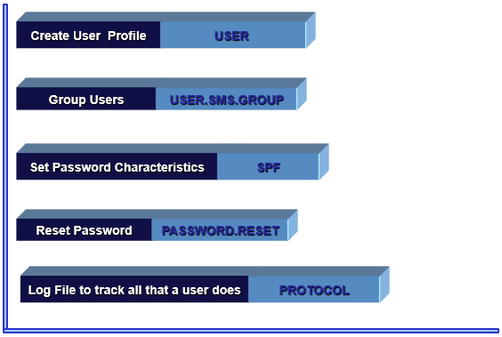
Basic Tables of SMS
Notes:
The above tables are used for implementing security management in T24. We will learn about these tables as we proceed in the course.

Slide 5
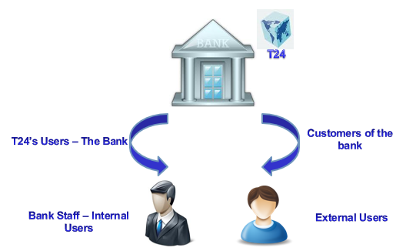
Types of System USERS
Notes:
When we use the term “ customers” , we refer to the customers of the bank . That is, customers who have a deposit in the bank or those who have taken a loan etc . These customers are linked to T24, when they do online banking. Hence we have a need to have 2 types of users. The bank employees are called the internal user. We create a profile for them using the USER application. The customers of the bank are called external users, and EB.EXTERNAL.USER holds the user profile of such customers.

Slide 6
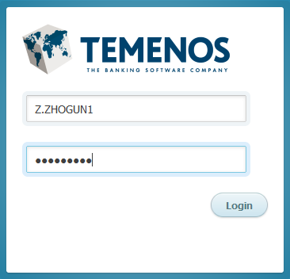
Our first encounter with SMS
To log into T24, a user needs to supply a sign on name and password
Password is masked when typed

Slide 7
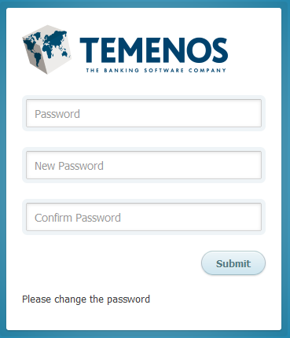
Password Characteristics
No more than two repeat characters
Last three passwords cannot be used
At first sign on, Temenos T24 will ask for Password to be input twice
Minimum of six characters and a maximum of 16
First Sign On By User
Notes:
Passwords in T24 must follow the rules discussed below.
Password should not have more than two repeated characters.
Last three passwords cannot be used.
At first sign on, Temenos T24 will ask for Password to be input twice.
Password should have a minimum of six and a maximum of sixteen characters.

Slide 8

SPF
What?
SPF stands for SYSTEM PARAMETER FILE
This table holds the installation specific details
It contains one record with ID as SYSTEM
We know that company specific settings are done using the COMPANY table. What if we want to set some parameters that are system wide, common to all companies in T24?
Such settings are done in SPF
Why?
Notes:
The SPF is the main parameter table in T24.
SPF stands for SYSTEM PARAMETER FILE
SPF holds the installation specific details.
This has only one record with ID as SYSTEM. If this record is corrupt, users will not be able to login to T24.
SPF is an INT type of file and therefore the file name at database level is F.SPF

Slide 9
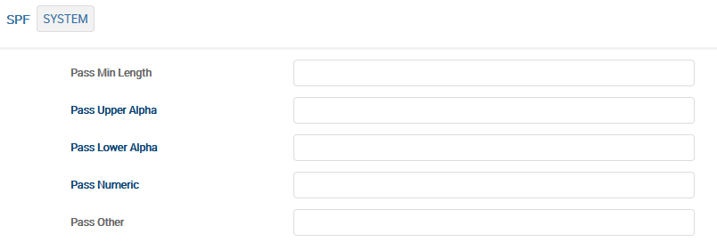
SPF – Password Characteristics and other features
Field in SPF | What do we set?
PWD.REPITITION | The default or minimum is three
PASS.MIN.LENGTH | Default minimum length of the password is 6 characters
PASS.UPPER.ALPHA | No of upper-case alphabets
PASS.LOWER.ALPHA | No of lower-case alphabets
PASS.NUMERIC | No of numerals
PASS.OTHER | Other special characters
PASS.UPPER.ALPHA + PASS.LOWER.ALPHA + PASS.NUMERIC + PASS.OTHER <= 16 AND > PASS.MIN.LENGTH
Notes:
Some of the other important fields :
RUN DATE : This field holds the server date when the COB was run last time.
SITE NAME : This field holds the name of the installation at which T24 is installed.
CURRENT RELEASE : This field holds the current T24 release.
HIST LIFE : This field defines the number of days for which the exception log in EXCEPTION.LOG.HIST file should be retained. EXCEPTION.LOG.FILE is used to log activities or business validation exceptions encountered by the applications run by the framework. This file was primarily used to log exceptions from within any process where there was no user interaction or where it was not possible to throw the exception at the user for the user to make a decision. Initially it was for end of day batch jobs but with the new service oriented architecture, it may as well apply for online services (TSA Services) running at the back-ground.
CACHE EXPIRY : This field specifies the time interval in seconds before the cache file refreshes.
Enquiry is a request to view data of a record from the database level.
ENQ PAGE LIMIT : The maximum number of pages of output of an enquiry that can be viewed. Irrespective of this value, at the time of printing, all pages of output will be printed.

Slide 10
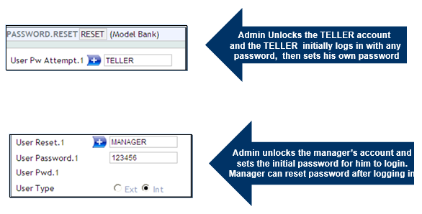
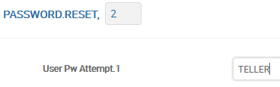
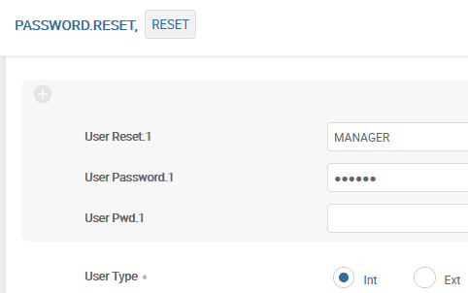
How to get a new Password
Notes:
What if you forget your password? What if your account is locked since you unsuccessfully tried different passwords and exceeded the maximum number of attempts? The application PASSWORD.RESET will allow an administrator to reset your account. You may not have access to this application.
The ID of a record in PASSWORD.RESET can be any alphanumeric text.
USER PW ATTEMPT: This field specifies the ID of the user whose record has been locked. When this record is authorised T24 resets the password and enables the profile at the same time. You must set a new password the next time you log in.
If a user crosses the number of password attempts or if the user forgets the password, these can be set in the following fields:
User Attempt : Every user is given a specific number of password attempts after which the user account gets locked. Maximum number of password attempts is specified in the application USER. Such locked user accounts can be unlocked by giving the user name in the field User Attempt.
What if an administrator wants to activate a profile of an user even before the end of the deactivation period? You can achieve this by setting the following field.
User Deact Perd : Specifies the ID of the user for whom the security administrator wants to reactivate the profile before the end of the deactivation period.
User Reset : This field has the ID of a user whose password is to be reset.
User Password : A new password must be set in this associated field. This password will expire once you login and thus the user will be forced to change it on the sign-on.

Slide 11
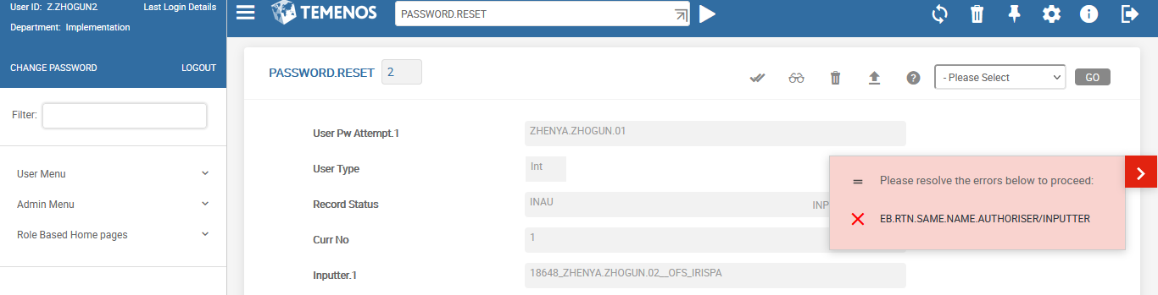
Inputter – Authorizer Mechanism
Any record in T24 requires
To be Input (I function)
To be Authorised (A function)
T24 does not allow one user to perform both the functions on the same record

Slide 12
USER application
What?
The user profile of a bank employee is a record in the USER application
All rights and privileges of a bank user are defined in the user profile
There are different roles in a bank and each role will need access to different types of data
Why?
Notes:
Every bank user who needs login and to perform any action in T24 needs to have a profile or in other words a record in USER application.
Rights and privileges for a user are defined in his user profile . For example, access given only to FUNDS TRANSFER and CUSTOMER application and also restrict the access only to Input and List functions.
The user profile is a record in the USER application

Slide 13
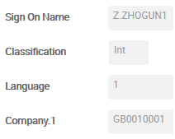
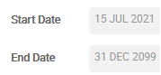
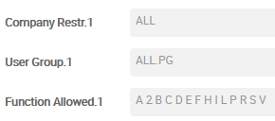
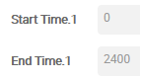
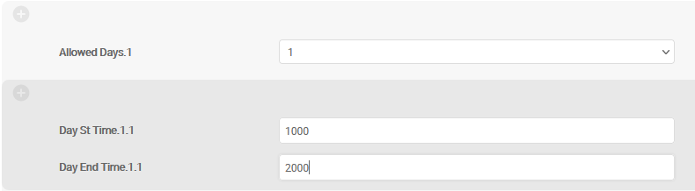
Create User Profile - USER
Log in ID, whether the user is a bank employee (Internal), language and company the user can access
Validity of the User
Time duration for which the user can work on T24 (for all 7 days)
Restrict access to applications, company wise
Specific time of access for certain days
1 – Mon , 2- Tue and so on
Notes:
Field «User Group» could contain application name, of “ALL.PG” for “all applications”, or USER.SMS.GROUP record.

Slide 14
Workshop - 1
Create a user named XXXXX (Where XXXXX is your name)
User should have access to any one company only – e.g. GB0010001
User should be allowed to access only the ACCOUNT and CUSTOMER applications
User should be allowed to use only functions
See and Print for the CUSTOMER application
Input and Copy for the ACCOUNT application
User should be able to use the command line (field ATTRIBUTES)
User should be able to use the system only between 06:00 and 21:00 on all days
Authorize the record and try logging in to T24 with this user
Notes:
(Additional info.)
(If we will add only «CUSTOMER» application with all functions, we still cannot use L function or any Enquiry. So we should add also ENQUIRY.SELECT application)

Slide 15
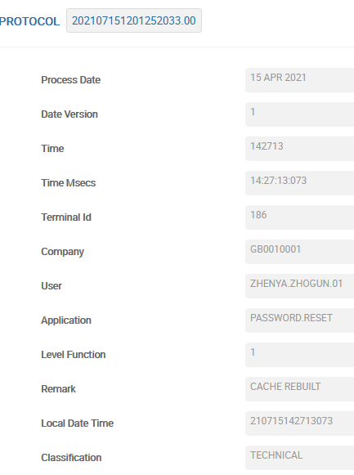
User Administration
T24 provides a file named PROTOCOL which can store
User login and logoff details
Security violations encountered by the user
User access of the various security management related applications in T24
Details of every application, function and record ID used by the user
Access this file using any one of the following ways
PRTOCOL L
ENQ %PROTOCOL

Slide 16
Grouping Users
What if a privilege or a set of privileges is to be set for a group of users because they belong to the same department?
Will you set the privileges in every single user’s user profile?
Would you like to create something like a role in an organization (set of privileges) and apply it to the relevant users?
Example: Managers, Teller, Head Teller, accountants, clerks.

Slide 17
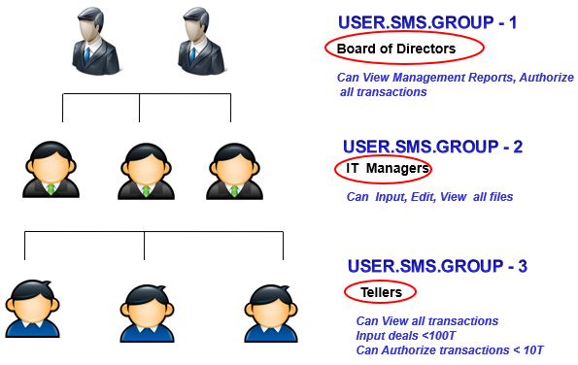
Grouping Users

Slide 18
USER.SMS.GROUP – an Example
There are about 10 Account Managers in the bank for whom the following privileges need to be granted
They should have access to CUSTOMER table
The functions allowed on the above table should only be Input, See, Delete and Authorize
The SMS Group created should be attached to individual user profile. In this case, should be attached to the APPLICATION field of every Account Manager’s USER profile

Slide 19

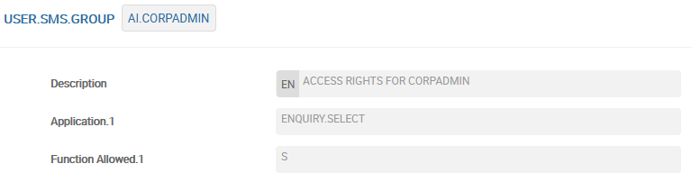
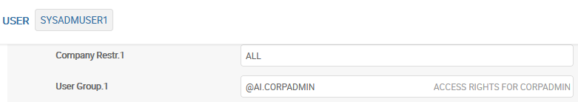

Grouping Users – USER.SMS.GROUP
Attaching User to any Group does not prevent this User from having any additional individual privileges.
Notes:
USER.SMS.GROUP is the application which is used to group users . The common rights to be provided for the entire group is set here. The id of SMS group is then linked to individual user profile in the application field and is prefixed with “@” symbol.

Slide 20
Workshop - 2
Create your own USER.SMS.GROUP
User Group should be allowed to use only functions Input, See, Delete, Authorize for Customer records whose field 23 SECTOR equals 1000
Attach this Group to your User Profile
Check the settings: try to view or enter different Customer records

Slide 21
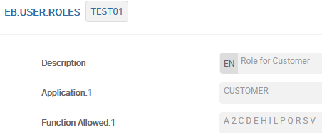
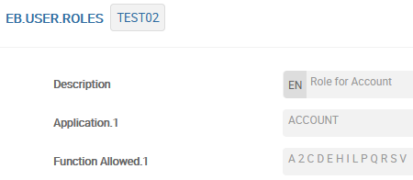
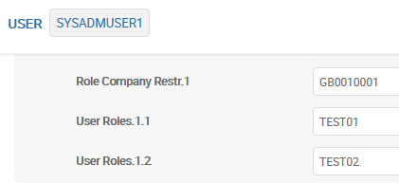
User Roles – EB.USER.ROLES
In addition to User Groups, there is an alternative, more stringent way to limit privileges - using User Roles
Attaching a User to any Roles DOES NOT allow this User to have additional individual privileges. All privileges will be determined only through a set of roles
Notes:
Field «Application» could contain application name, of “ALL.PG” for “all applications”, or USER.SMS.GROUP record.

Slide 22
Overrides
Override is a warning message generated by applications
Override is a configurable error in the system, i.e. the bank can decide to classify them as errors, if required
They are customized, based on Channels, amounts, currencies, type of transactions etc.
Notes:
An override in T24 is required in a situation where the user needs to be warned that he has to confirm the action which he would be performing.
For example, A customer wants to withdraw $100 from his savings account which has a balance of $150. Assume that by T24 norms, the minimum balance in the savings account should be $100. Now if you input the transaction to debit $100, when committing it T24 must warn you about the insufficient funds available. T24 cannot stop you, but it can warn you. T24 generates an override to do this. You will have only two options, to accept it and complete the transaction or reject it and stop.
1.2 Override Messages: These are warning messages, at least most of the time. A user may accept or reject override. If accepted, T24 saves the record and the override message is stored as part of it in the field OVERRIDE. If you do not want to accept the Override, you may either put the record on hold to correct it later or amend the record and commit it again.

Slide 23
Types of Overrides
There are 2 types of Overrides:
Non-Blocked (a record which generates non-blocked overrides can be authorised by any user in T24)
Blocked (a record which generates blocked overrides can be authorised only by users with appropriate privileges)
Notes:
. There can be two different types of override messages. They are Non Blocked and Blocked overrides
2. A record which generates non blocked overrides can be authorised by any user in T24
3. A record which generates blocked overrides can be authorised only by users with appropriate privileges. If you do not have sufficient privileges the record will go to INAO (Input Not Approved due to Override) status
4. By default, all overrides in T24 are Non Blocked in nature

Slide 24
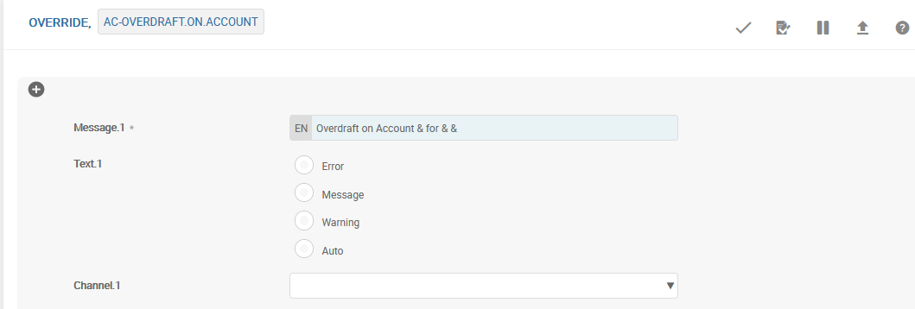
OVERRIDE Application
Notes:
In the OVERRIDE Application. T24 applications generate override messages stored here.
ID : ID of the record can be any meaningful alphanumeric string
GB Message : This field contains the actual override message that is displayed on committing the record.
So are override messages only static text messages? What if they need to hold values from the transaction? In that case, the override message will also contain a special character ‘&’ and each ‘&’ is then replaced with a value when T24 actually generates the override.
In the override ACCT.UNAUTH.OD, the first & is used to denote Currency, the second & to denote Amount and the third & to denote Account number.
Type, Channel and Approve Method : These fields are used only in ARC IB and are not in the scope of this learning unit. However, to give you little information about Channel field, based on the type of Channel you select to access T24 (like call center, branch, internet, etc.,), you can set this Override message to act differently such as a warning message, an error message, a confirmation message, etc.,.

Slide 25
Blocked Overrides
Blocked Overrides also generated at commit time
No special permissions required at this stage – anyone can accept overrides
Record goes to INAU
When authorizing record, T24 checks for appropriate permission
If OK, record is authorised, else – INAO status

Slide 26
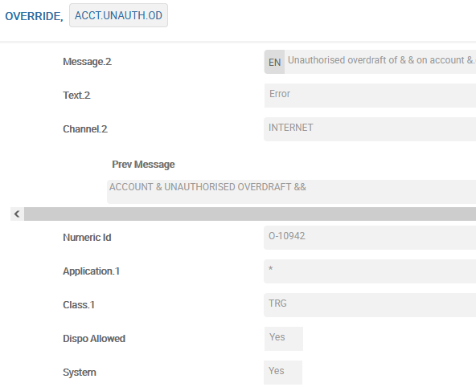
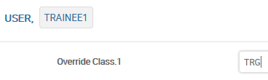
Restricted Approval Access using OVERRIDE Application
Specify Application = * and irrespective of the application from which this override is generated, only users with Class TRG in their User profile can accept the override.
Notes:
To grant the privilege to authorise records that have generated blocked overrides, you must use the OVERRIDE.CLASS field in the USER application. This field accepts any string data. The relationship of this data entered here and the override is clearly visible from the screen shots.
The override record has been modified to include the user class details thus making it a blocked override.
The user TRAINEE1 can now authorise the record which generated the ACCT.UNAUTH.OD override.
You will now learn more uses of the fields APPLICATION and CLASS in the OVERRIDE application.
Application : Specify a * to denote, irrespective of the application from which this override is generated, only users with Class TRG in their User profile can accept the override.
You can also specify Class Application wise. For example, if the Override is generated in the FUNDS.TRANSFER application, then only users with Class TEM in their User profiles can accept it.
Class : This field specifies a group name. Users belonging to this group alone will be able to approve this override. Class name can be any descriptive text. Maximum of four characters only. The group name specified in this field should be attached in the User profiles in the field ‘Override Class’.

Slide 27
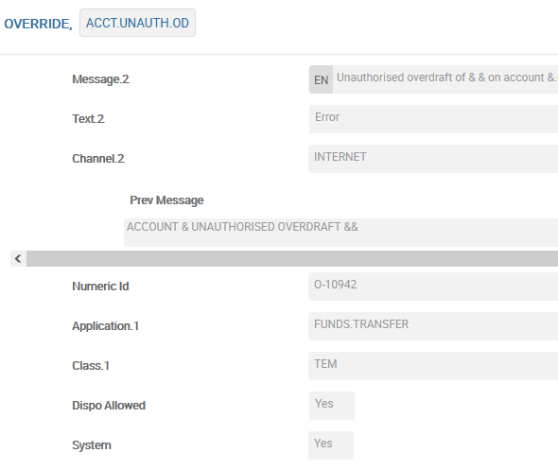
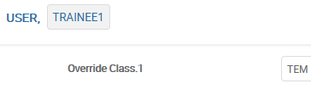
Restricted Approval Access using OVERRIDE Application
If the Override is generated in the FUNDS.TRANSFER application, then only users with Class TEM in their User profiles can accept it.
Notes:
To grant the privilege to authorise records that have generated blocked overrides, you must use the OVERRIDE.CLASS field in the USER application. This field accepts any string data. The relationship of this data entered here and the override is clearly visible from the screen shots.
The override record has been modified to include the user class details thus making it a blocked override.
The user TRAINEE1 can now authorise the record which generated the ACCT.UNAUTH.OD override.
You will now learn more uses of the fields APPLICATION and CLASS in the OVERRIDE application.
Application : Specify a * to denote, irrespective of the application from which this override is generated, only users with Class TRG in their User profile can accept the override.
You can also specify Class Application wise. For example, if the Override is generated in the FUNDS.TRANSFER application, then only users with Class TEM in their User profiles can accept it.
Class : This field specifies a group name. Users belonging to this group alone will be able to approve this override. Class name can be any descriptive text. Maximum of four characters only. The group name specified in this field should be attached in the User profiles in the field ‘Override Class’.

Slide 28
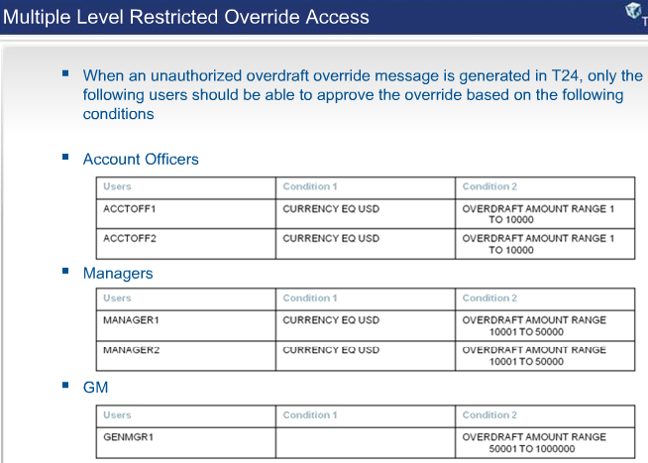
Multiple Level Restricted Override Access
When an unauthorized overdraft override message is generated in T24, only the following users should be able to approve the override based on the following conditions:
Notes:
1. When an unauthorized overdraft override message is generated in T24, only the following users should be able to approve the override based on the following conditions
2. Account Officer classification
Table Row 1 : Only the user ACCTOFF1 can approve the override if the currency is USD and the overdraft amount is in the range one to 10000
Table Row 2 : Only the user ACCTOFF2 can approve the override if the currency is USD and the overdraft amount is in the range one to 10000
3. Manager classification
Table Row 1 : Only the user MANAGER1 can approve the override if the currency is USD and the overdraft amount is in the range 10001 to 50000
Table Row 2 : Only the user MANAGER2 can approve the override if the currency is USD and the overdraft amount is in the range 10001 to 50000
4. GM classification
Table Row 1 : Only the user GENMGR1 can approve the override if the overdraft amount is in the range 50001 to 1000000

Slide 29
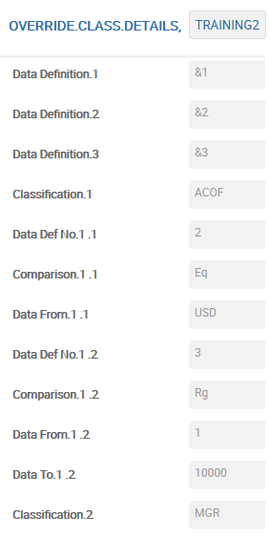
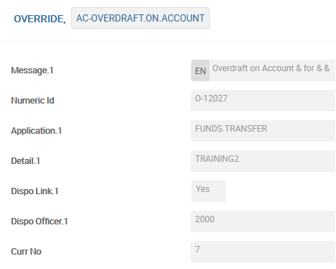
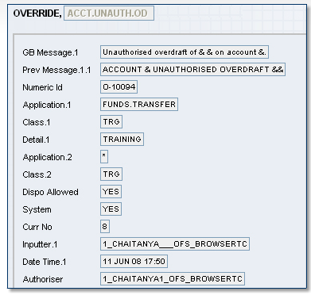
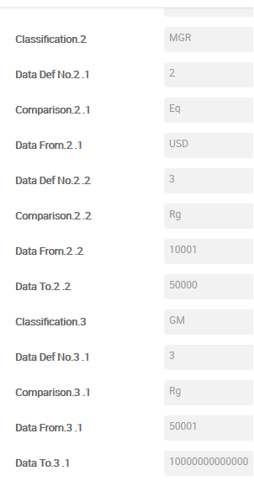
OVERRIDE.CLASS.DETAILS Application
Notes:
To set the multiple level restrictions to approve an override you have to use the application OVERRIDE.CLASS.DETAILS. You can set different groups who can approve overrides only if the conditions specified in their groups are satisfied.
Data Def : This field refers to the & values in the override message. ACCT.UNAUTH.OD is the Override in which &1 refers to Currency, &2 refers to Amount and &3 refers to Account. In this example, conditions are specific to only Currency and Amount and hence only &1 and &2 are defined.
Classification to Data To field is a multi value set.
Data Def No to Data To field is a sub value set.
Classification : This field holds any user defined text that best defines the group classification.
Data Def No. : This field indicates which data item, as defined in the field DATA DEF is to be used for the classification.
The number in this field identifies which multi-value from the field DATA DEF is to be referred. For example, the number '1' indicates that it is the data item defined by field DATA DEF.1 and the number '2' indicates that it is the content of field DATA DEF.2 . You can also define one DATA DEF and use it for all the classifications.

Slide 30
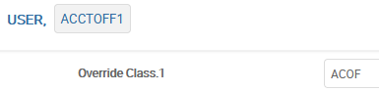
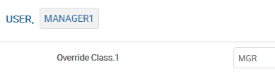
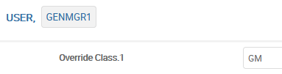
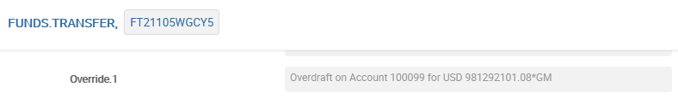
Specify the Classes in the appropriate User Profiles
Notes:
Specify the value given in the field CLASSIFICATION (first multi value set) in OVERRIDE.CLASS.DETAILS and in the field OVERRIDE CLASS in the User profiles of ACCTOFF1 and ACCTOFF2.
Specify the value given in the field CLASSIFICATION (second multi value set) in OVERRIDE.CLASS.DETAILS and in the field OVERRIDE CLASS in the User profiles of MANAGER1 and MANAGER2.
Specify the value given in the field CLASSIFICATION (third multi value set) in OVERRIDE.CLASS.DETAILS and in the field OVERRIDE CLASS in the User profiles of GENMGR1.

Slide 31
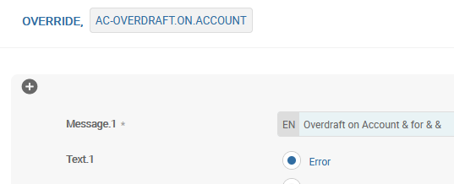
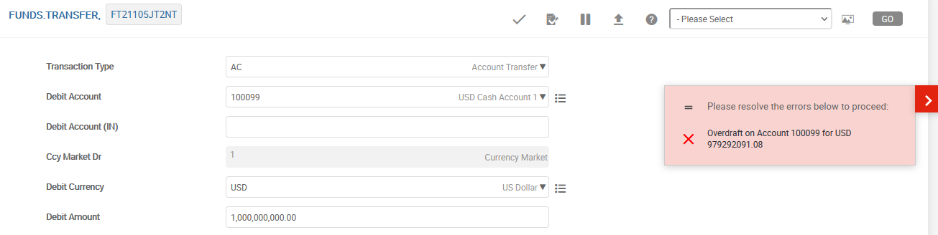
Overrides as Errors
Notes:
You are now familiar with the concept of override processing in T24. Can an override message be triggered as an error in T24?
The answer is yes. The field TYPE in OVERRIDE application has the following options – Error, Auto, Message and Warning. When TYPE is set to Error, the override message becomes an error. When TYPE is set to Auto, the override message will be automatically accepted by T24 , the user acceptance is not required.

Slide 32
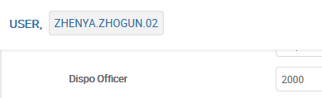
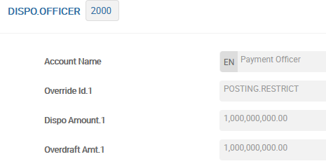
DISPO – re-assigning of system Overrides
In Security Management System there is possibility of re-assigning of system Overrides. It is necessary for cases when the occurred override while entering a transaction goes beyond the User’s privileges. For example, when entering a money transfer, an overdraft on the account may occur, which must be agreed with the management:
Step 1: special User record should be created for the person who has privileges to work with re-assigned Overrides – DISPO.OFFICER.
Step 2: ID of created DISPO.OFFICER record is placed in appropriate User record.
Notes:
OVERRIDE.ID The override problem that this officer will deal with.
Currently Dispo processing only supports the following overrides that are used in FUNDS.TRNSFER:
ACCOUNT.INACTIVE ACCT.BAL.LT.LOCKED
ACCT.UNAUTH.OD ADVISED.EXCESS
CHQ.NO.NOT.PRESENT CHQ.NO.STOPPED
CHQ.NOT.IN.REG CHQ.PRESENTED
CHQ.PRINTED CHQ.STOP.ON.AMT
DISPO.LIMIT EXCESS.ID
LIMIT.EXPIRED LIMIT.UNAVAIL
NO.CHQ.AMT.VAL NO.CHQ.ISSUED
POSTING.RESTRICT POSTING.RESTRICT.CUST
Other Overrides may be enhanced to allow them dispo processing (OVERRIDE>DISPO = YES)

Slide 33
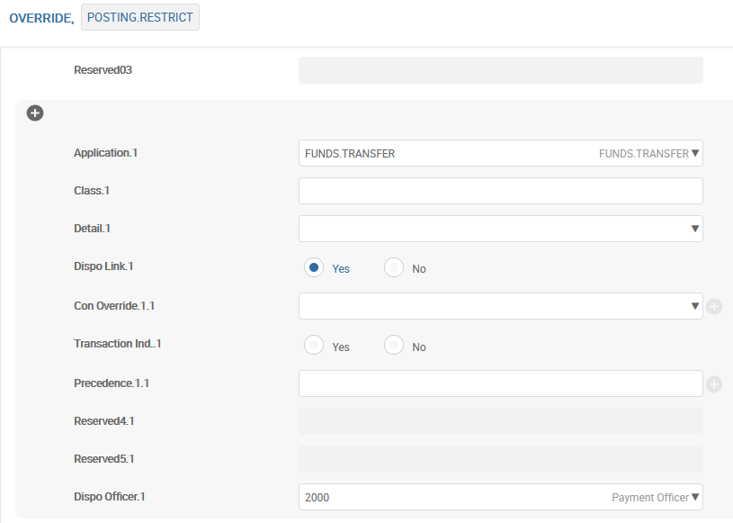
DISPO – re-assigning of system Overrides
Step 3: in the appropriate record of application OVERRIDE, that includes the text of Override, fill in the Application, Dispo Link and Dispo Officer fields.
Notes:
OVERRIDE.ID The override problem that this officer will deal with.
Currently Dispo processing only supports the following overrides that are used in FUNDS.TRNSFER:
ACCOUNT.INACTIVE ACCT.BAL.LT.LOCKED
ACCT.UNAUTH.OD ADVISED.EXCESS
CHQ.NO.NOT.PRESENT CHQ.NO.STOPPED
CHQ.NOT.IN.REG CHQ.PRESENTED
CHQ.PRINTED CHQ.STOP.ON.AMT
DISPO.LIMIT EXCESS.ID
LIMIT.EXPIRED LIMIT.UNAVAIL
NO.CHQ.AMT.VAL NO.CHQ.ISSUED
POSTING.RESTRICT POSTING.RESTRICT.CUST
Other Overrides may be enhanced to allow them dispo processing (OVERRIDE>DISPO = YES)

Slide 34
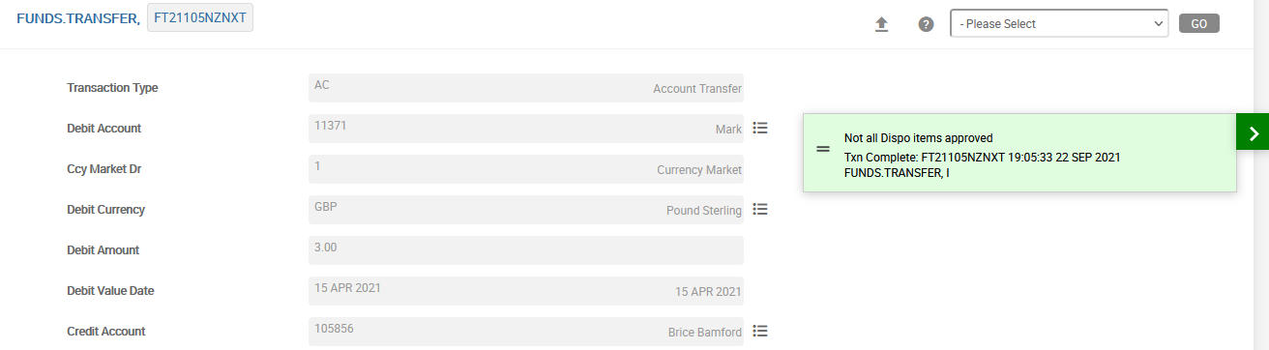
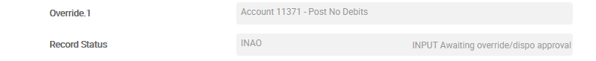
DISPO – re-assigning of system Overrides
Step 4: Example. When inputting of money transfer (application FUNDS.TRANSFER) - there is Posting Restrict on the account occurs that must be agreed with the management.
Audit fields in this record:

Slide 35
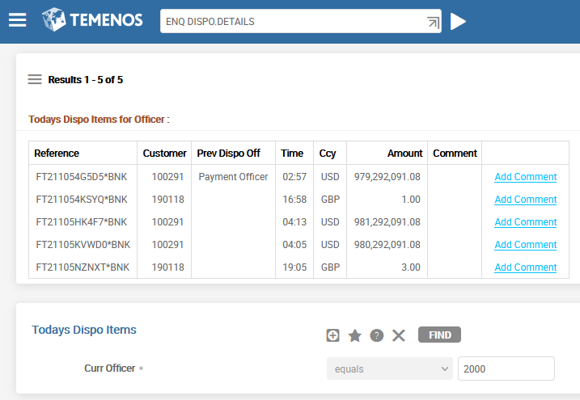
DISPO – re-assigning of system Overrides
Step 5: with help of Enquiry DISPO.DETAILS we can see all the Overrides re-assigned to this User:

Slide 36
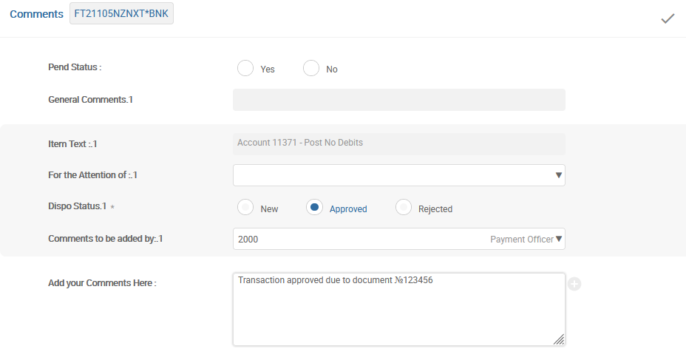
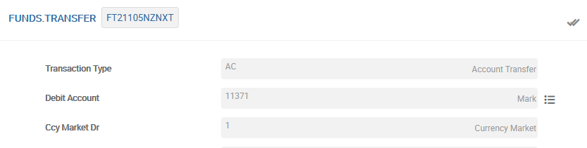
DISPO – re-assigning of system Overrides
Step 6: after clicking the reference «Add Comment» the User can make his decision and/or re-assign the Override to another User, with making any comment. Or user could just Approve this record and Authorize FT record which will be opened automatically:
Notes:
Альтернативным способом определения уполномоченного в приложении OVERRIDE является поле PRECEDENCE. В нём задаётся поле соответствующего приложения, вызвавшего оверрайд (по шаблону APPLICATION>FIELDNAME), в котором следует искать номер DISPO.OFFICER-а.

Slide 37
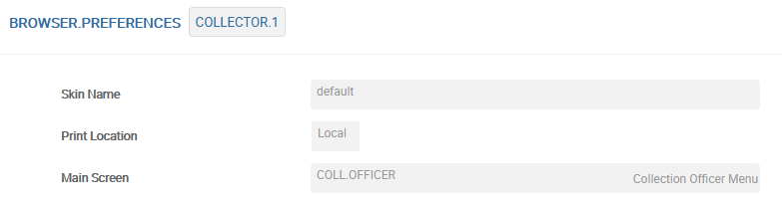
BROWSER.PREFERENCES
The BROWSER.PREFERENCES application controls the screen that is presented to the user when they log into T24.
ID = USER
Composite Screen from EB.COMPOSITE.SCREEN

Slide 38
Thank you for your time and attention!
FORANX LLC
Legal address:
35A, Ponomarenko str., 201 office, Minsk, 220015, Belarus
Tel.:+ 375 17 202 76 78
+ 375 17 202 76 79
Fax: + 375 17 362 34 22
Web-site: www.foranx.by
Minsk, 2021

